Slide 1


TradeTracker Pro: Complete User Documentation
This document provides comprehensive user documentation for TradeTracker Pro, a lightweight storefront builder with integrated income and expense tracking capabilities. It is specifically designed for small traders and business owners seeking an efficient solution for managing their finances and online presence. The application uniquely leverages voice and photo input for streamlined data entry, making financial management more accessible and less time-consuming.
by Collins Joshua

Slide 2
Introduction and Overview
TradeTracker Pro is an innovative application engineered to streamline business operations for a diverse range of small traders and business owners, including retail merchants, market vendors, and service providers. Its primary purpose is to simplify and automate crucial aspects of business management, from building an online storefront to meticulously tracking every income and expense.
The core functionality of TradeTracker Pro encompasses a robust storefront builder, intuitive inventory management tools, and comprehensive financial tracking features. Designed for flexibility, the system is accessible across various platforms, working seamlessly on both iOS and Android mobile devices, as well as standard web browsers, ensuring traders can manage their business on the go or from their desktop.
What truly sets TradeTracker Pro apart from conventional solutions are its key differentiators: advanced voice input technology for hands-free data entry, sophisticated photo receipt scanning that automatically extracts critical financial details, and an overall lightweight design that prioritizes ease of use without compromising on powerful features. These innovations collectively provide a user-friendly and highly efficient financial management experience tailored specifically for the dynamic needs of small businesses.

Slide 3
Getting Started
Embarking on your TradeTracker Pro journey begins with a straightforward account creation and setup process. New users are guided through a series of intuitive steps to establish their business profile, ensuring a personalized experience from the outset.
Upon successful setup, you will be introduced to the Dashboard, which serves as the central hub for all your business activities. This main interface provides a real-time overview of your financial status, key performance indicators, and quick access to all essential features. Initial configuration steps include setting up your business name, contact information, currency preferences, and basic tax details, all designed to get you operational swiftly.
For businesses transitioning to TradeTracker Pro, the application offers convenient options for importing existing business data, such as inventory lists, customer databases, and historical transaction records, ensuring a smooth migration. Furthermore, users can delve into setting detailed business preferences and customization options, tailoring the application to their unique operational flow. Mobile app installation is seamless, with clear instructions provided for both iOS and Android devices, ensuring easy desktop synchronization for a unified and accessible business management experience across all your platforms.

Slide 4
Storefront Builder
TradeTracker Pro empowers small traders to create their professional digital storefronts in mere minutes, eliminating the need for complex coding or design expertise. The storefront builder offers a diverse selection of customizable templates, meticulously designed to suit various business types, from retail goods to artisanal crafts.
Central to the storefront is robust product catalog management, allowing for effortless organization of your offerings. Users can easily upload high-quality product images and write compelling descriptions, showcasing their items with clarity and appeal. The system provides flexible options for setting pricing, applying discounts, and creating special offers to attract and retain customers. Integrated inventory tracking ensures you always have an accurate count of your stock, with configurable low-stock alerts to prevent overselling and facilitate timely reordering.
Every storefront created with TradeTracker Pro is inherently mobile-responsive, guaranteeing an optimal viewing and shopping experience for your customers, regardless of the device they use. Furthermore, the platform supports integrated payment processing options, allowing you to securely accept various forms of payment directly through your digital storefront, streamlining the sales process from start to finish.

Slide 5
Income and Expense Tracking
TradeTracker Pro provides a dynamic dashboard overview of your financial status, offering real-time insights into your business's health. Recording sales transactions and incoming revenue is intuitive, ensuring every dollar earned is accurately captured.
The application simplifies expense management through comprehensive categorization and tagging features, allowing for detailed tracking of where your money is going. A standout feature is the voice input capability for quick expense recording, enabling hands-free data entry, which is particularly useful for traders on the go. Complementing this is the photo receipt capture function, which leverages advanced technology to automatically extract critical data from receipts, minimizing manual entry and reducing errors.
For a holistic financial view, TradeTracker Pro supports seamless bank account and credit card integration, automatically syncing transactions to keep your records up-to-date. Users can also efficiently manage recurring transactions, such as subscriptions or rent, ensuring consistent tracking without repetitive manual input. For businesses operating internationally, multi-currency support handles diverse transactions with ease. The system also offers valuable tax calculation and preparation assistance, streamlining the process of generating financial summaries for tax season.

Slide 6
Advanced Features
Voice Command System for Hands-Free Operation TradeTracker Pro features a sophisticated voice command system, allowing users to navigate the application and record transactions entirely hands-free. This enhances efficiency, especially for busy traders who need to multitask or are frequently on the move. Simple voice prompts can initiate actions like "Record Sale," "Add Expense," or "Check Inventory," providing unparalleled convenience.
Natural Language Processing for Transaction Entry Our cutting-edge Natural Language Processing (NLP) enables users to input transaction details using everyday language. Instead of filling out forms, you can simply state "Sold five widgets for fifty dollars to John Doe" or "Paid twenty dollars for office supplies from Amazon," and the system intelligently parses and records the information, including amounts, categories, and contacts.
Photo Receipt Scanning with OCR Technology Leveraging Optical Character Recognition (OCR) technology, TradeTracker Pro allows you to simply snap a photo of any receipt. The system automatically extracts key information such as vendor name, date, amount, and even itemized lists, converting physical receipts into digital records instantly and accurately. This significantly reduces manual data entry and helps maintain meticulous records.
Automated Expense Categorization using AI Our integrated Artificial Intelligence (AI) learns from your previous entries to automatically categorize expenses. For example, if you frequently categorize "Starbucks" as "Meals & Entertainment," the AI will suggest or automatically apply this category for future Starbucks transactions. This intelligent automation saves time and ensures consistent and accurate expense tracking.

Slide 7
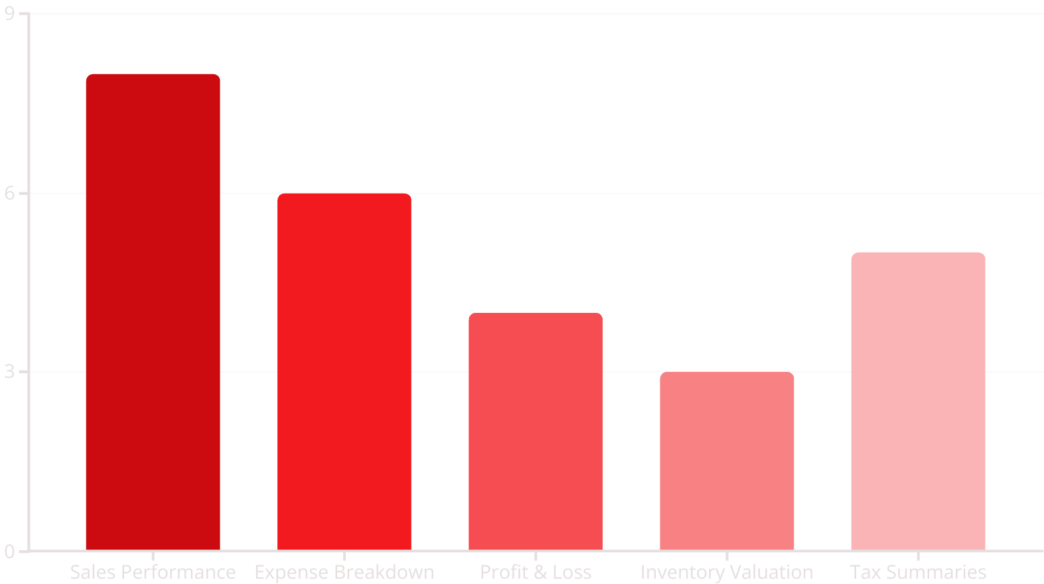
Reports and Analytics
TradeTracker Pro offers a comprehensive suite of reports and analytics, providing small traders with invaluable insights into their business performance. Detailed sales performance metrics and visualizations allow you to track revenue trends, identify best-selling products, and understand customer purchasing patterns. Expense breakdown reports provide clear visibility into spending by category and over customizable time periods, helping you pinpoint areas for cost optimization.
The application seamlessly generates essential financial documents, including robust Profit and Loss (P&L) statements, giving you a clear picture of your business's profitability. Inventory valuation and turnover reports help manage stock levels efficiently, minimizing waste and optimizing cash flow. For tax season, TradeTracker Pro provides tax-ready financial summaries, simplifying the preparation process and ensuring compliance.
All reports come with flexible export capabilities, allowing you to download data in various formats such as PDF, CSV, and Excel, for easy sharing or further analysis. For unique business requirements, a custom report builder enables you to design specialized reports tailored to your specific needs. Furthermore, the platform supports comparative analysis (month-over-month, year-over-year) and features visual dashboards with key performance indicators (KPIs), empowering you to make informed, data-driven decisions and strategically plan for future growth.

Slide 8
Support and Resources
TradeTracker Pro is committed to ensuring a seamless user experience, backed by a robust ecosystem of support and resources. New users can take advantage of in-app tutorials and guided tours that walk them through every feature, from initial setup to advanced financial tracking. A comprehensive troubleshooting guide addresses common issues, providing immediate solutions to frequently encountered challenges.
Users will stay informed with regular system updates and maintenance information, ensuring optimal performance and access to the latest features and security enhancements. Speaking of security, TradeTracker Pro prioritizes your data protection with advanced security features, including encryption and secure access protocols, safeguarding your sensitive business information.
For peer-to-peer assistance and shared knowledge, a vibrant community forum is available, alongside an extensive knowledge base filled with articles and how-to guides. Direct contact information for technical support is provided for any issues requiring personalized assistance. Additionally, a comprehensive Frequently Asked Questions (FAQ) section offers quick answers to common queries. To enhance learning, a rich library of video tutorials and detailed documentation is accessible at all times. Finally, users can keep an eye on the future with information about upcoming features and our development roadmap, ensuring you're always aware of exciting new additions to TradeTracker Pro.

